Slide 1

This Photo by Unknown Author is licensed under CC BY

Slide 2
Overview
This project involves a comprehensive analysis of Netflix's movies and TV shows data using SQL. The goal is to extract valuable insights and answer various business questions based on the dataset. The following README provides a detailed account of the project's objectives, business problems, solutions, findings, and conclusions.

Slide 3
Objectives
Analyze the distribution of content types (movies vs TV shows).
Identify the most common ratings for movies and TV shows.
List and analyze content based on release years, countries, and durations.
Explore and categorize content based on specific criteria and keywords.

Slide 4
Business Problems & Solutions
1. Count the number of Movies vs TV Shows
2. Find the most common rating for movies and TV shows
3. List all movies released in a specific year (e.g., 2020)
4. Find the top 5 countries with the most content on Netflix
5. Identify the longest movie
6. Find content added in the last 5 years
7. Find all the movies/TV shows by director 'Rajiv Chilaka'!
8. List all TV shows with more than 5 seasons.
9. Count the number of content items in each genre
10.Find each year and the average numbers of content release in India on netflix. return top 5 year with highest avg content release!

Slide 5
Business Problems & Solutions
11. List all movies that are documentaries
12. Find all content without a director
13. Find how many movies actor 'Salman Khan' appeared in last 10 years!
14. Find the top 10 actors who have appeared in the highest number of movies produced in India.
15. Categorize the content based on the presence of the keywords 'kill' and 'violence' in the description field. Label content containing these keywords as 'Bad' and all other content as 'Good'. Count how many items fall into each category.

Slide 6
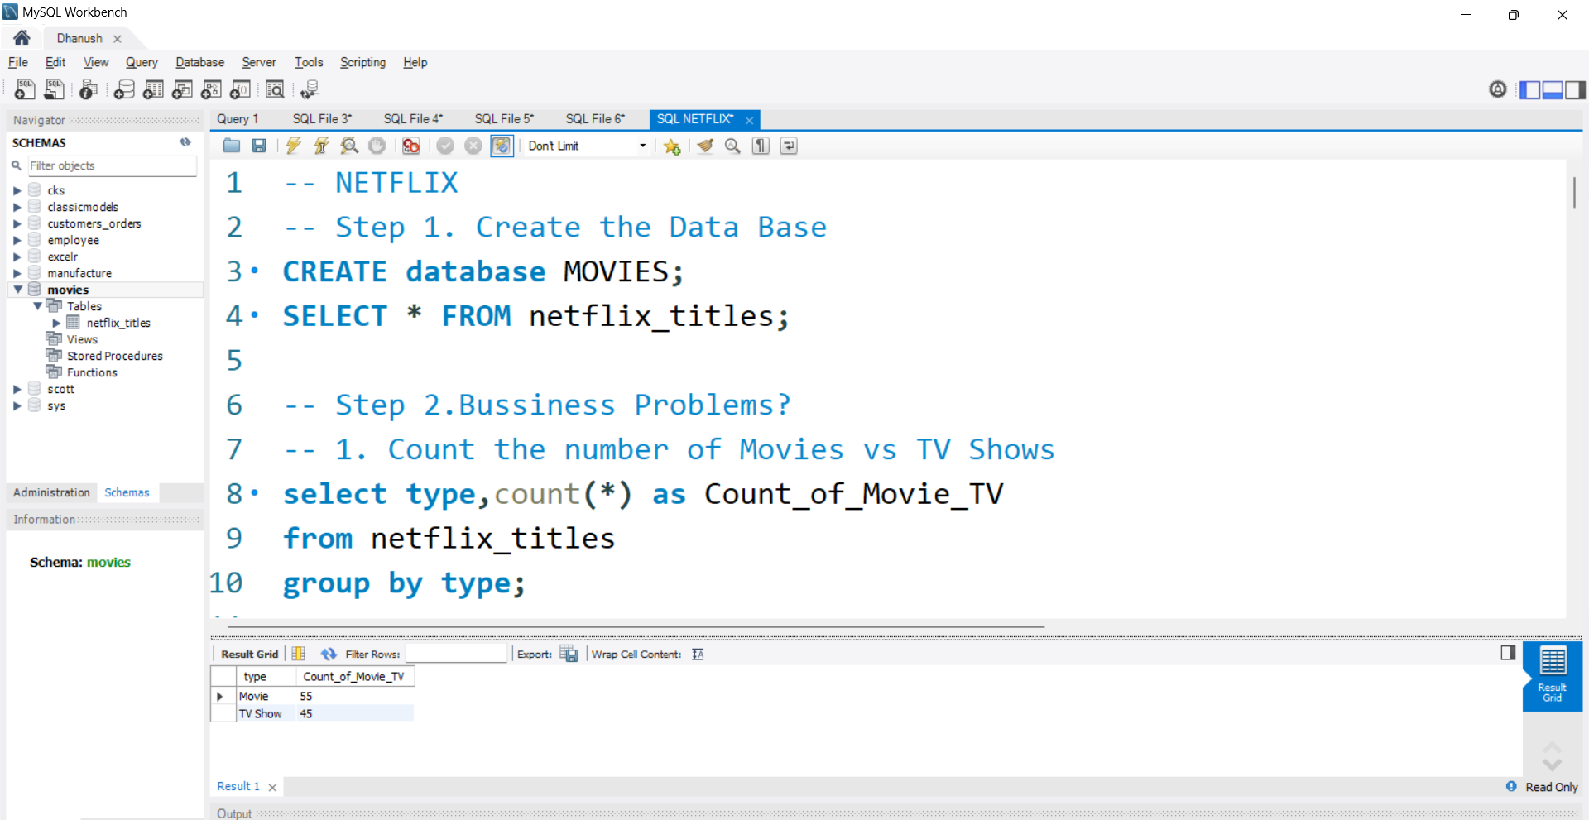
Solutions of 15 business problems
1. Count the number of Movies vs TV Shows

Slide 7
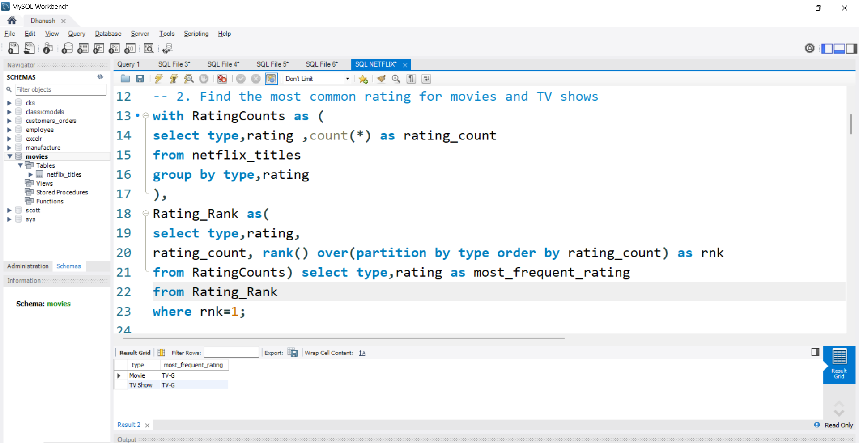
2. Find the most common rating for movies and TV shows

Slide 8
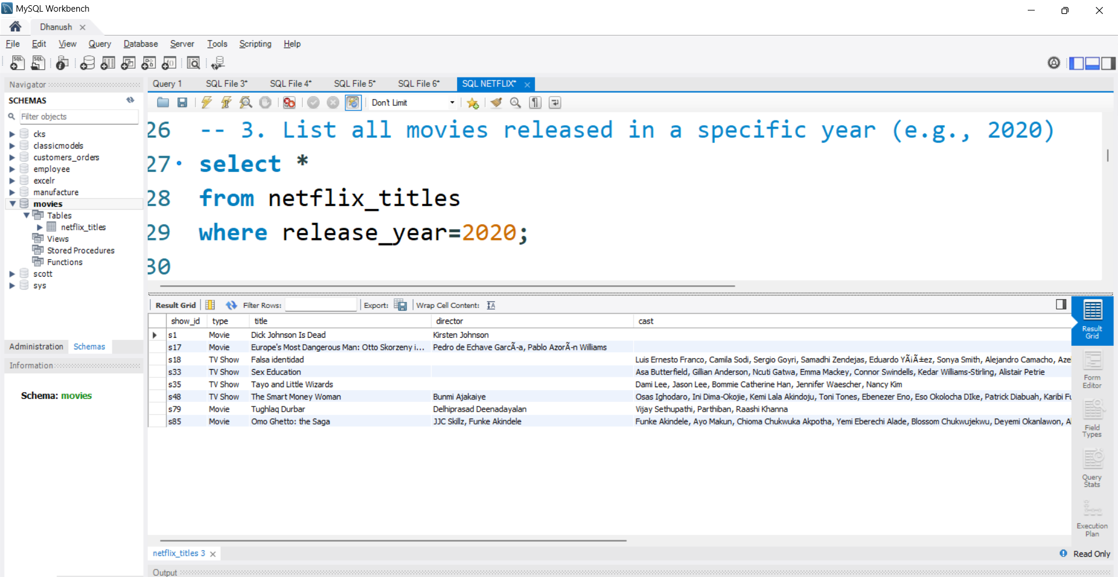
3. List all movies released in a specific year (e.g., 2020)

Slide 9
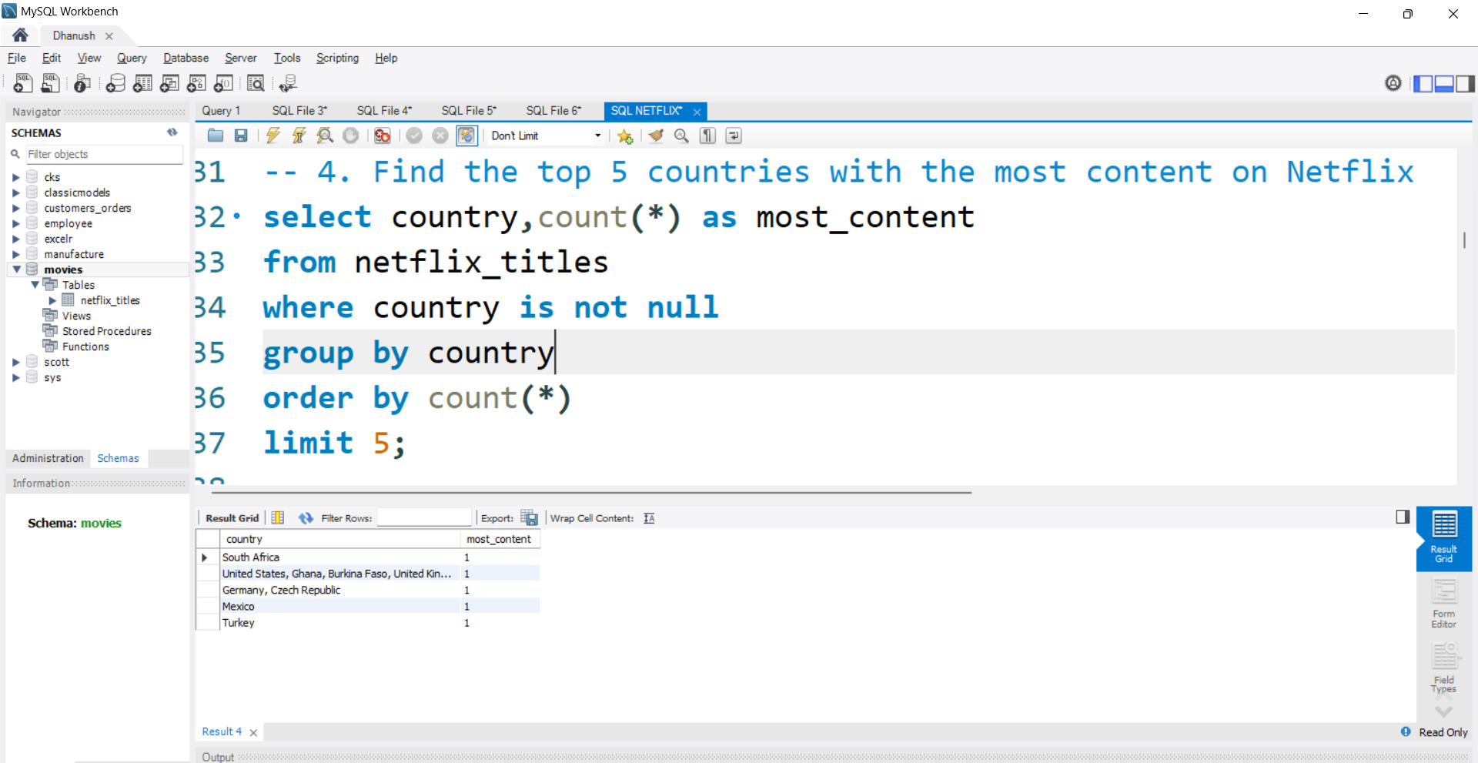
4. Find the top 5 countries with the most content on Netflix

Slide 10
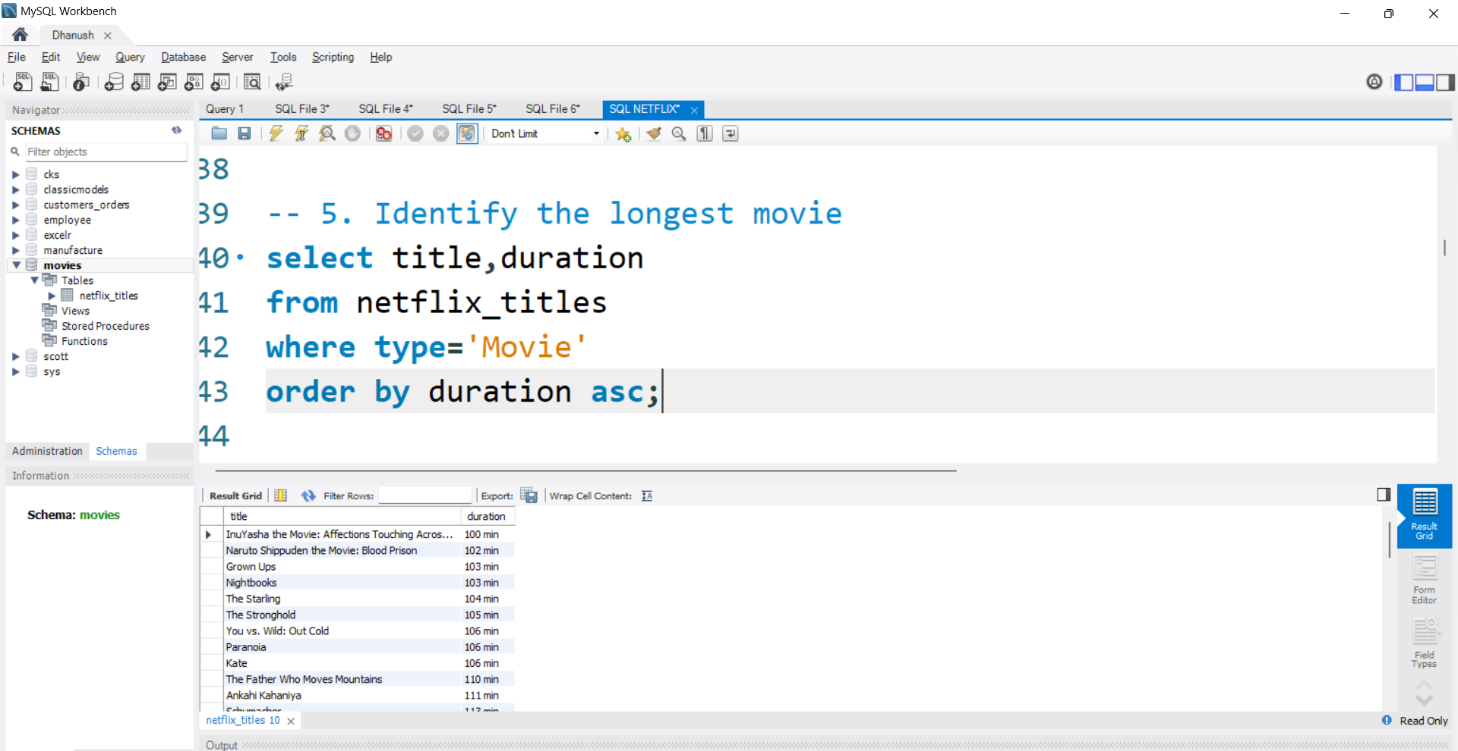
5. Identify the longest movie

Slide 11
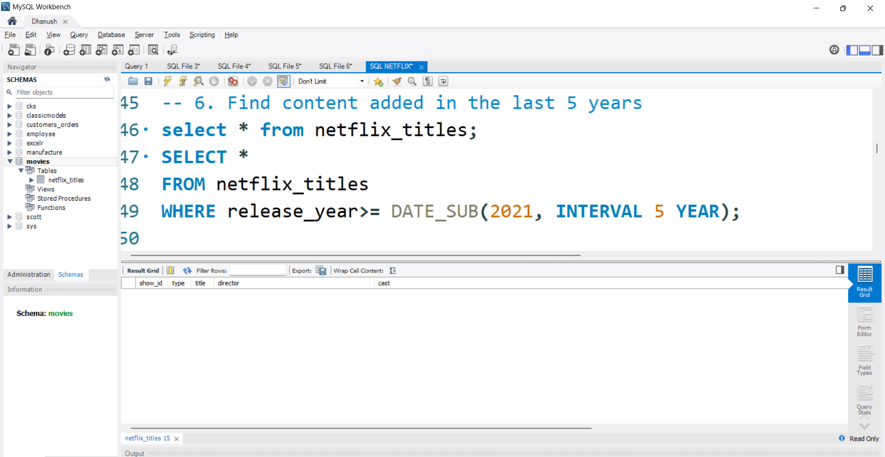
6. Find content added in the last 5 years

Slide 12
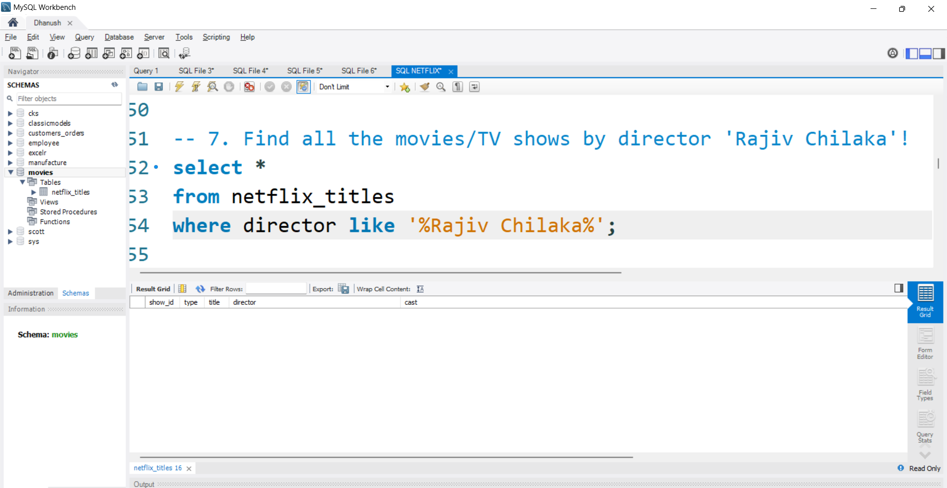
7. Find all the movies/TV shows by director 'Rajiv Chilaka'!

Slide 13
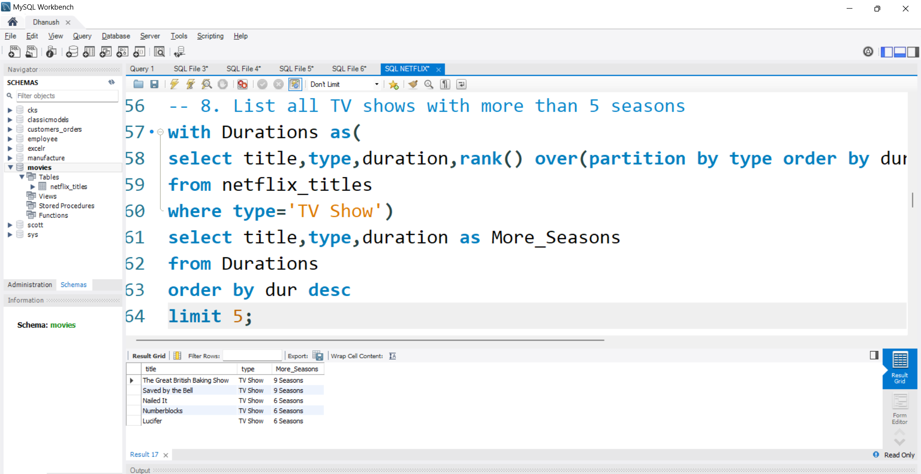
8. List all TV shows with more than 5 seasons.

Slide 14
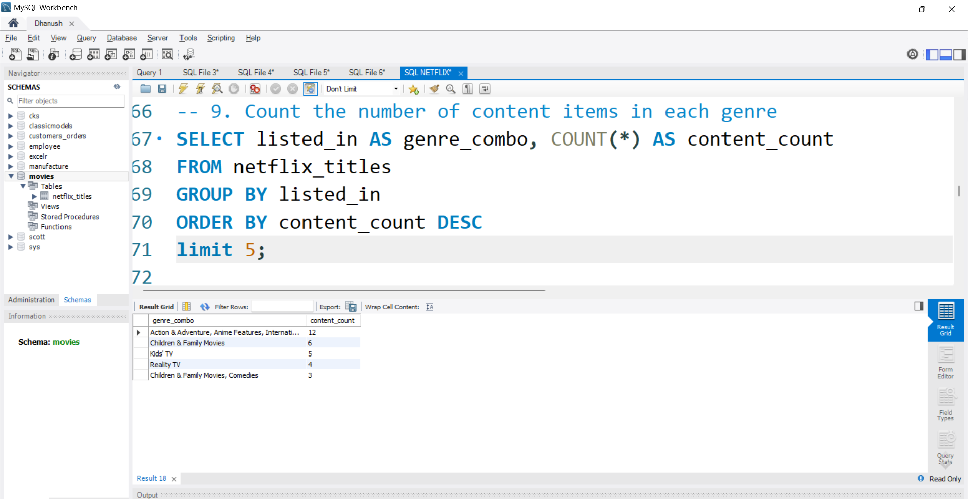
9. Count the number of content items in each genre

Slide 15
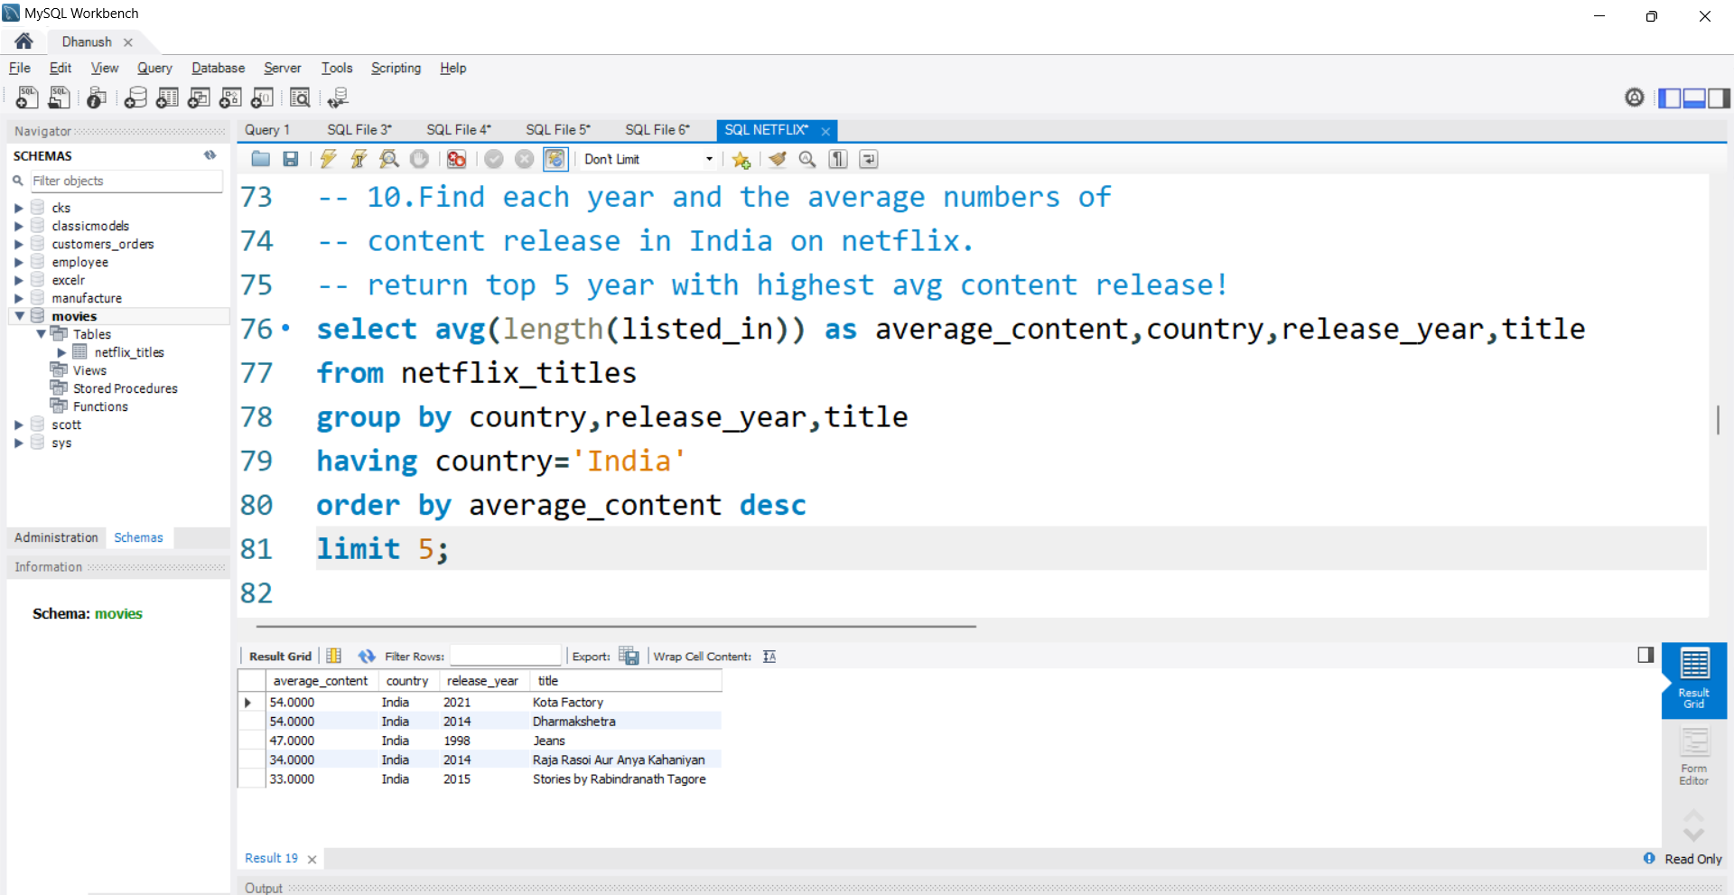
10.Find each year and the average numbers of content release in India on netflix. return top 5 year with highest avg content release!

Slide 16
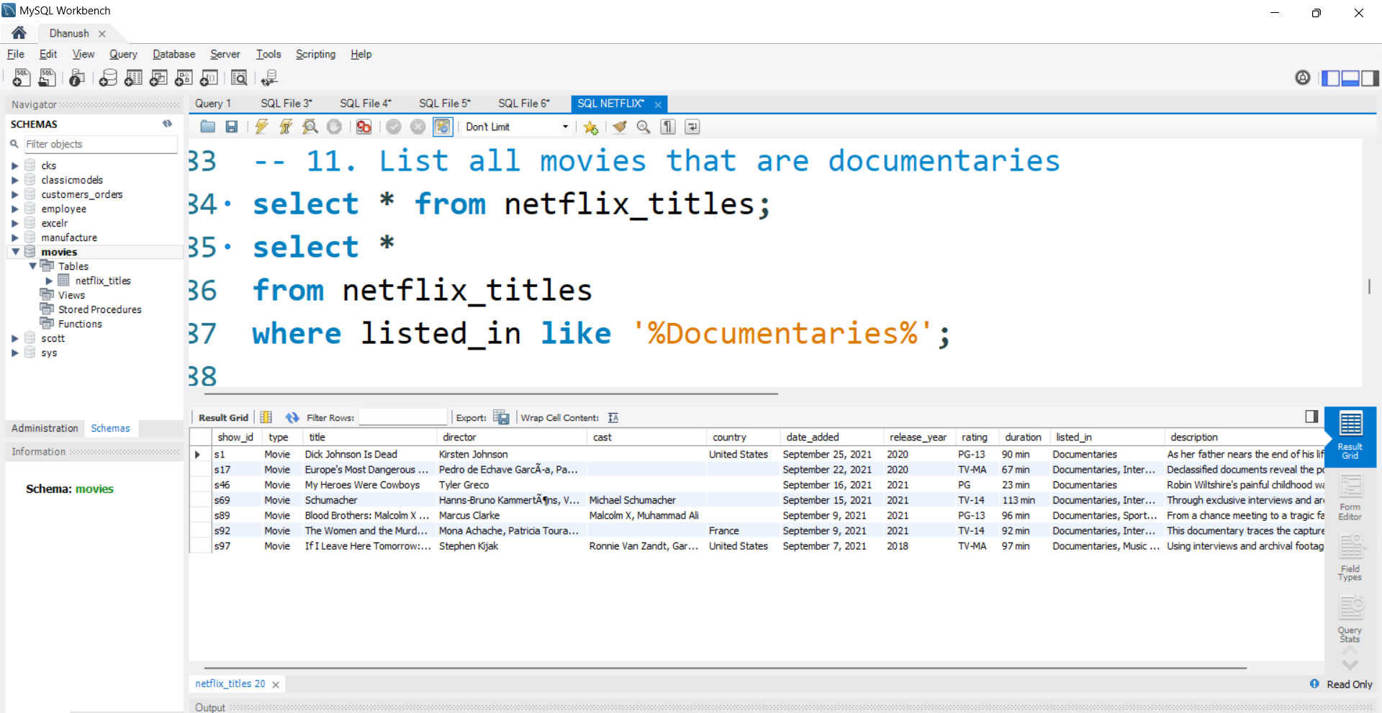
11. List all movies that are documentaries

Slide 17
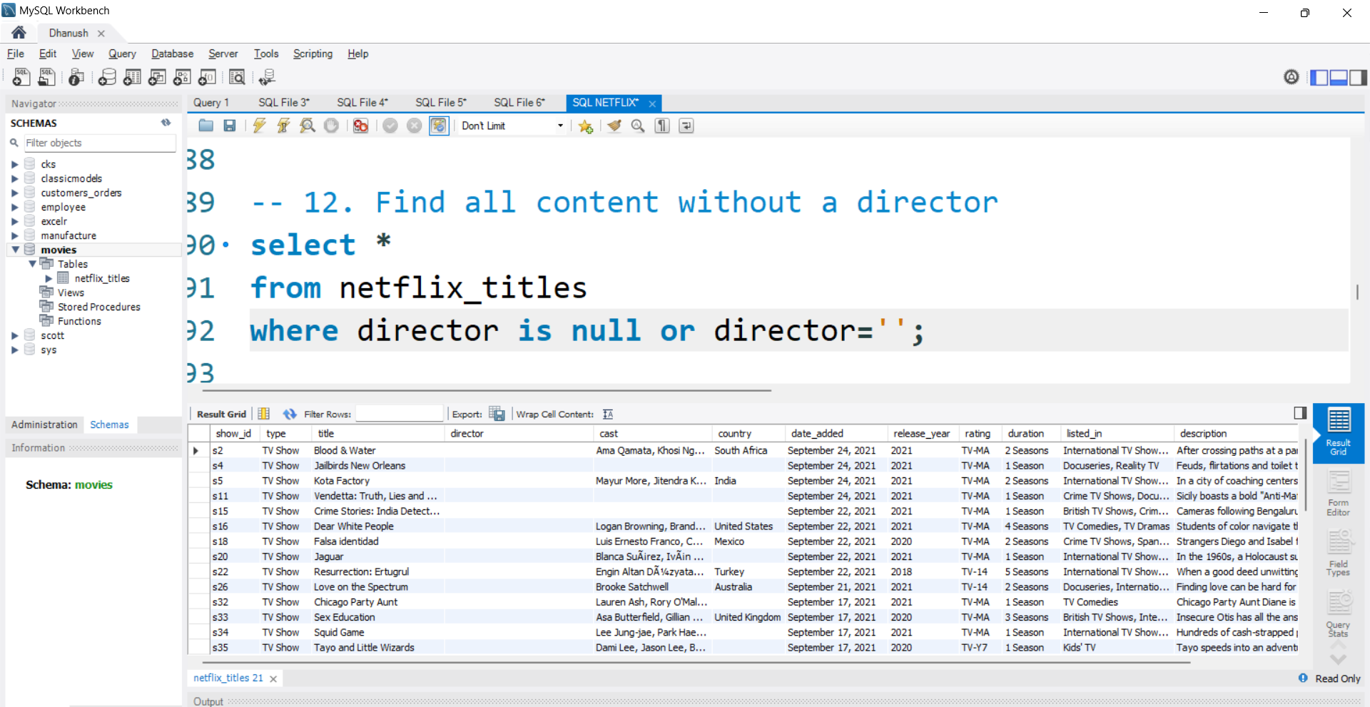
12. Find all content without a director

Slide 18
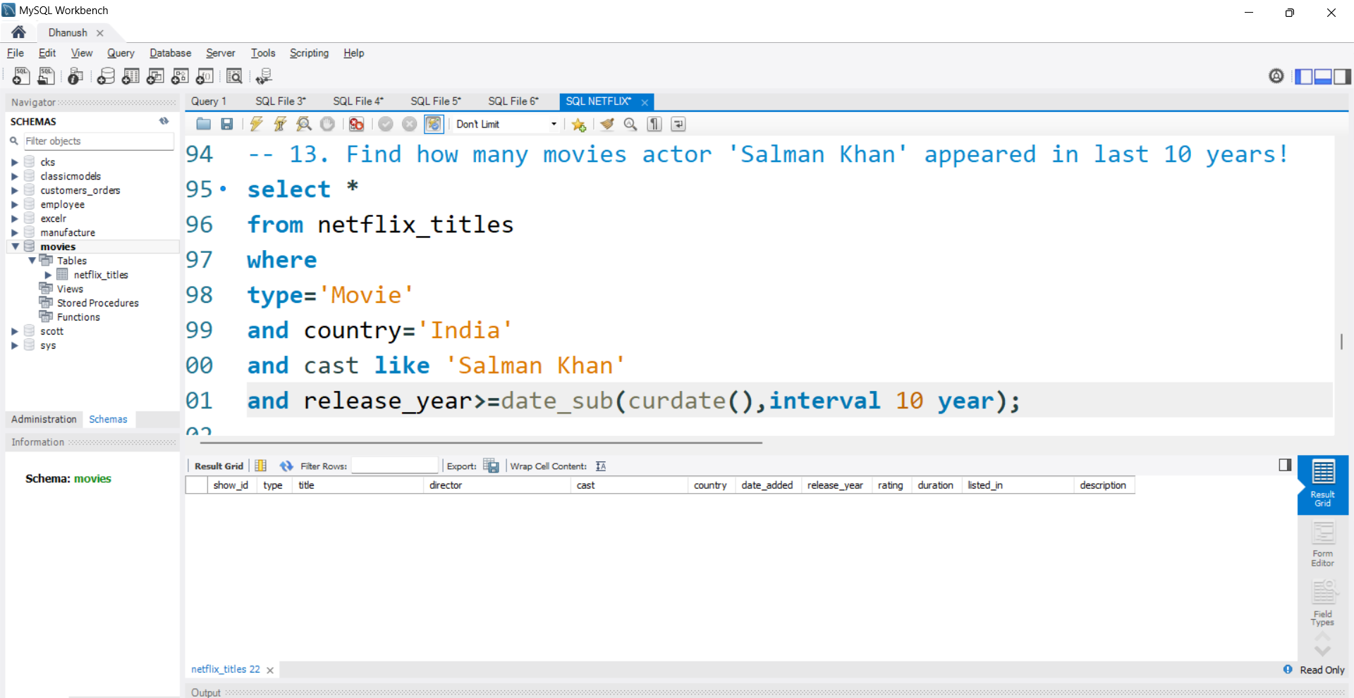
13. Find how many movies actor 'Salman Khan' appeared in last 10 years!

Slide 19
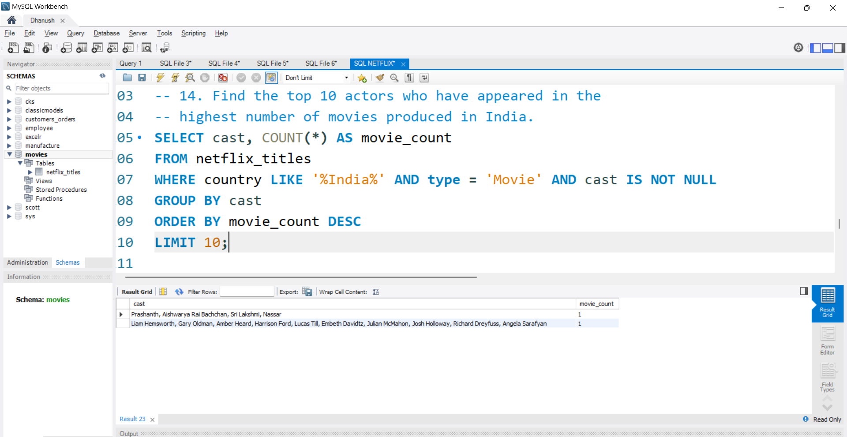
14. Find the top 10 actors who have appeared in the highest number of movies produced in India.

Slide 20
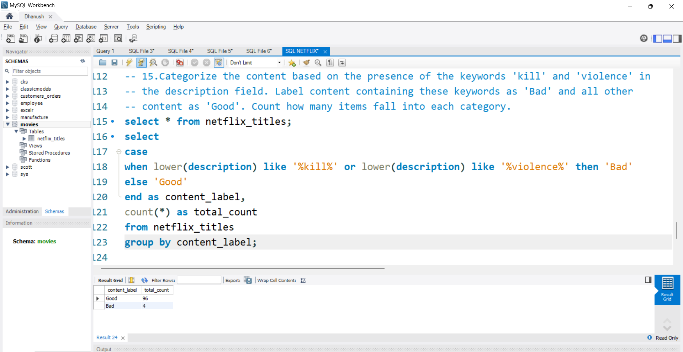
15. Categorize the content based on the presence of the keywords 'kill' and 'violence' in the description field. Label content containing these keywords as 'Bad' and all other content as 'Good'. Count how many items fall into each category.

